Slide 1
Introduction to Information Systems and Programming
Static Typing
ArrayList, LinkedList
Iterating

Slide 2
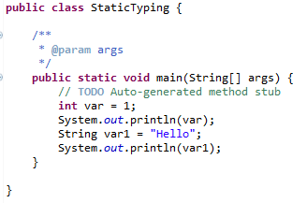
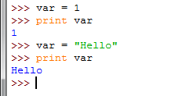
Static Typing
Java vs. Python: Java requires declaration of the variables, specifying the types of variables
The variable type stipulates: (i) the set of values that can be taken and (ii) the operations that can be performed on those values
Java is a statically-typed language
Java
Python
No declaration, variable types depend on results of assignments / program execution

Slide 3
Python is not statically-typed
No declaration, variable types depend on results of assignments / program execution
Sometimes impossible to resolve the variable type before program execution

Slide 4
Python is not statically-typed
No declaration, variable types depend on results of assignments / program execution
Sometimes impossible to resolve the variable type before program execution
var1 =1
userInput = int(input("enter a number: "))
if userInput > 1:
var2 = "hello"
else:
var2 = 10
var3 = var1 + var2
print var3

Slide 5
Static Typing
Java is a statically-typed language
The types of all variables are known at compile time
Can perform type checking statically (checking before the program even runs)
In dynamically-typed languages like Python, this type checking is deferred until execution time (while the program is running)
Many ideas in this course / modern programming language is to eliminate bugs from the code, and static typing is one idea
int e1 = 24;
String e2 = "hello";
e2 = e1;
/* found before program execution */
Program in high-level programming language
Machine code / Bytecode
compile
execute
Result

Slide 6
Automatic checking provided by the programming language
Static checking: the bug is found automatically before the program even runs
Dynamic checking: the bug is found automatically when the code is executed
No automatic checking: the language does not help you find such error; you have to watch for it yourself, or your program produces wrong results
int e1 = 24;
System.out.println(e1/0);
/* runtime error detected by JVM */
int big = 2000000000;
// 2,000,000,000
big = big * 2;
/* Overflow error, cannot be detected by JVM */

Slide 7
Static vs Dynamic Typing
Static Typing | Dynamic Typing
Verbose | Concise
Early feedback before runtime | Late feedback during runtime
Easier maintenance – more organized code | Maintenance may be difficult and error-prone
Longer average development time | Shorter average development time
Better inherent code documentation | Need to be supplemented by explicit documentation
Design – static types help organize thinking during implementation | Design rigor needs to be enforced
Notes:
Dynamically typed programming languages can express all correct programs

Slide 8
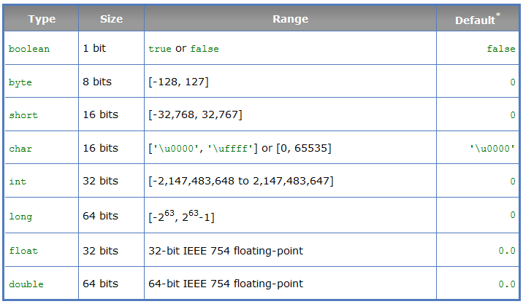
Primitive Types
int number = 0; vs int[] number = {1,2,3};

Slide 9
ArrayList, LinkedList
Array: once the array is created, its size is fixed
Example: int [] a = new int [10];
ArrayList / LinkedList: can be used to store unlimited number of objects

Slide 10
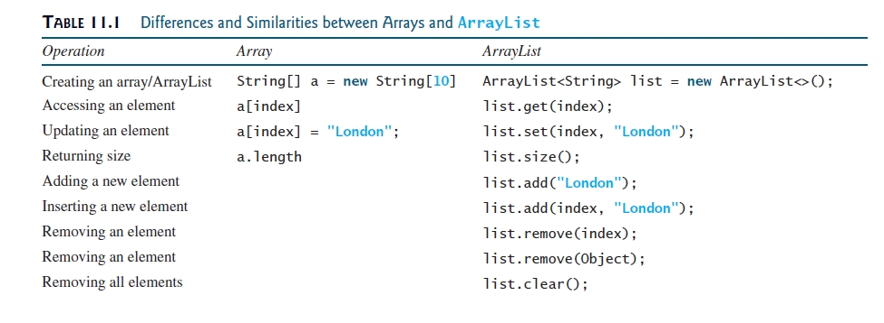
ArrayList, LinkedList

Slide 11
ArrayList, LinkedList
Operations for ArrayList and LinkedList are similar (both implemented the List interface)
Underlying mechanisms are different:
ArrayList stores elements in an array; if the capacity is exceeded, a larger new array will be created and all the elements are copied to the new array
LinkedList stores elements in a linked list data structure
Have different performance for various operations, e.g. ArrayList is more efficient to support random access through an index

Slide 12
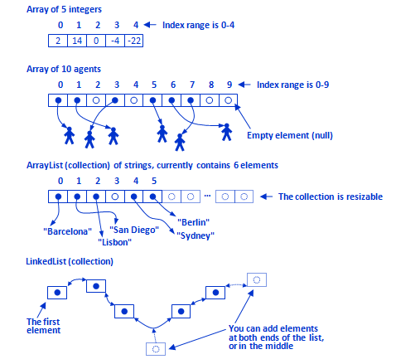
Array, ArrayList, LinkedList

Slide 13
Performance: Random Access
public class PerformanceCheck { public static void main(String[] args) { Integer[] a = new Integer[50000]; List<Integer> w = new LinkedList<>(Arrays.asList(a)); long started = System.nanoTime(); int totalCnt = 100000; for (int k=0; k< totalCnt; k++) { w.get(25000); } long time = System.nanoTime(); long timeTaken = time - started; System.out.println("time taken:" + timeTaken/1000000.0 + "ms"); } }

Slide 14
Performance: Random Access
ArrayList: 3.3ms
LinkedList: 4269ms

Slide 15
Performance: Insertion
public class PerformanceCheck { public static void main(String[] args) { Integer[] a = new Integer[50000]; List<Integer> w = new ArrayList<>(Arrays.asList(a)); long started = System.nanoTime(); int totalCnt = 100000; for (int k=0; k<totalCnt; k++){ w.add(5,2000); // insertion } long time = System.nanoTime(); long timeTaken = time - started; System.out.println("time taken:" + timeTaken/1000000.0 + "ms"); } }

Slide 16
Performance: Insertion
ArrayList: 1859ms
LinkedList: 13.33ms

Slide 17
Generics
Generics is a programming language design to use type as parameter
ArrayList<String> w1 = new ArrayList<String>();
ArrayList<Integer> w2 = new ArrayList<Integer>();
ArrayList<String> w3 = new ArrayList<>();

Slide 18
Generics
Detect error at compile time rather than runtime, i.e., static checking
More reliable
ArrayList<String> l = new ArrayList<String>(); l.add("hello"); l.add("bye"); l.add("haha"); l.add(2); // error detect at compile time

Slide 19
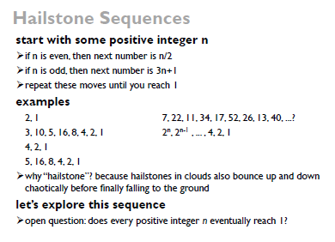
Activity: write a Java program to create a Hailstone Sequences using ArrayList or LinkedList. At the end of your program, you will have the entire sequence stored in the respective data-structure. Report the max value in the sequence started from n=3.

Slide 20
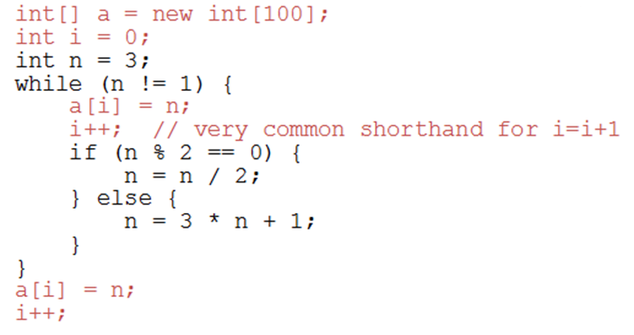
Using an Array
What is the issue?

Slide 21
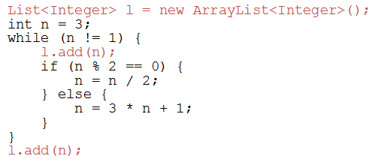
Using ArrayList (Collection)
ArrayList<Integer> l = new ArrayList<Integer>();

Slide 22
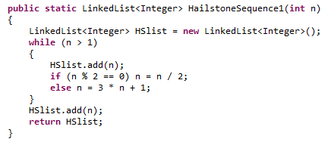
Using LinkedList (Collection)
Some associated methods: getFirst(), getLast(), remove()

Slide 23
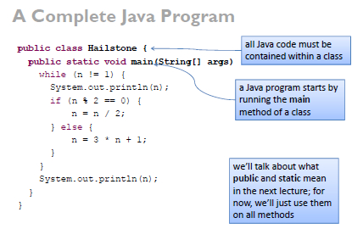
Methods

Slide 24


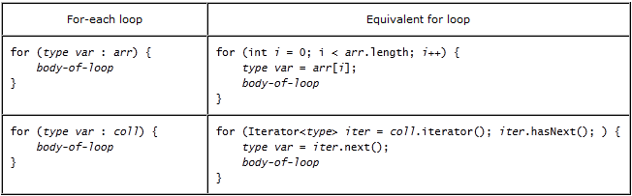
Iteration Types

Slide 25
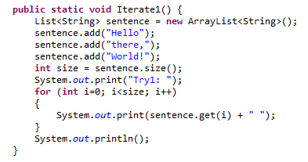
Iterating
ArrayList<String> sentence = new ArrayList<String>();
Use index

Slide 26
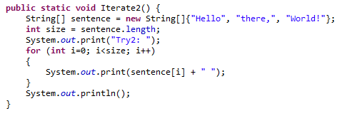
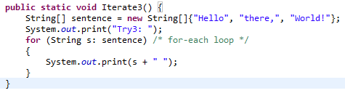
Iterating
for-each loop

Slide 27
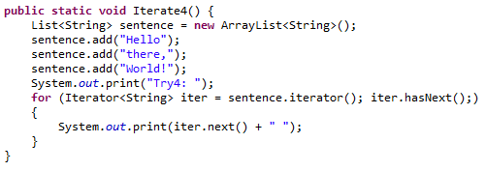
Iterating
ArrayList<String> sentence = new ArrayList<String>();
Use an iterator

Slide 28
Activity
Write a program that uses an iterator to compute the sum of all integer values in an ArrayList of integers
Write a second code segment that does the same thing but using a for-each loop

Slide 29
Summary
Static typing – Java vs Python
Static vs Dynamic typing – pros and cons
Implementing Hailstone Sequencer – Arrays and Collections
Different forms of iteration
Complete program – class structure and methods (main)
Cohort Section Activities – reinforce understanding and experience to implement basic Java applications

